Slide 1

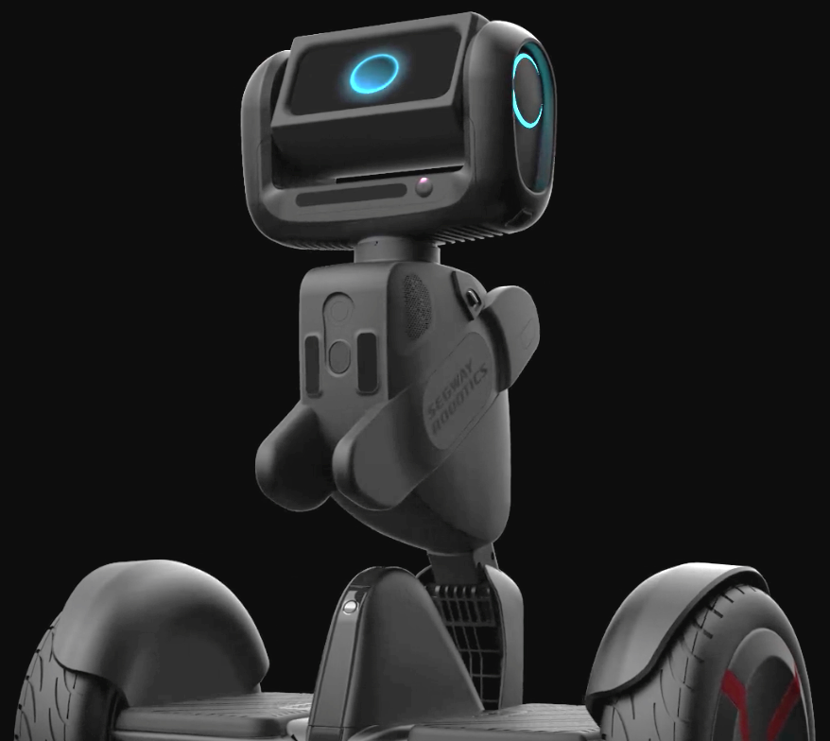




Buddy
personalized walking companion
Lauren Bigelow
Business
Kevin Jackson
Medical student
Wardah Inam
Robotics
Sudipta Swarnakar
Developer
Tammy Hsu
Medical student
Sunny Chin
Clinical Content Consultant
Notes:
Our team has been busy this weekend -- we’ve created working prototype of Buddy, your personalized walking companion and we’d like to tell you about it

Slide 2
The Problem: Less Exercise = More Disease
It’s dangerous not to move. Limited mobility increases your risks for:
heart attacks dementia
osteoporosis Obesity
diabetes mortality osteoarthritis
High
cholesterol
High
Blood pressure
cancer
“Effects of Walking on Coronary Heart Disease in Elderly Men.” Circulation 1999.
Abbott. “Walking and Dementia in Physically Capable Elderly Men.” JAMA 2004.
https://www.unm.edu/~lkravitz/Article%20folder/age.html)

Slide 3
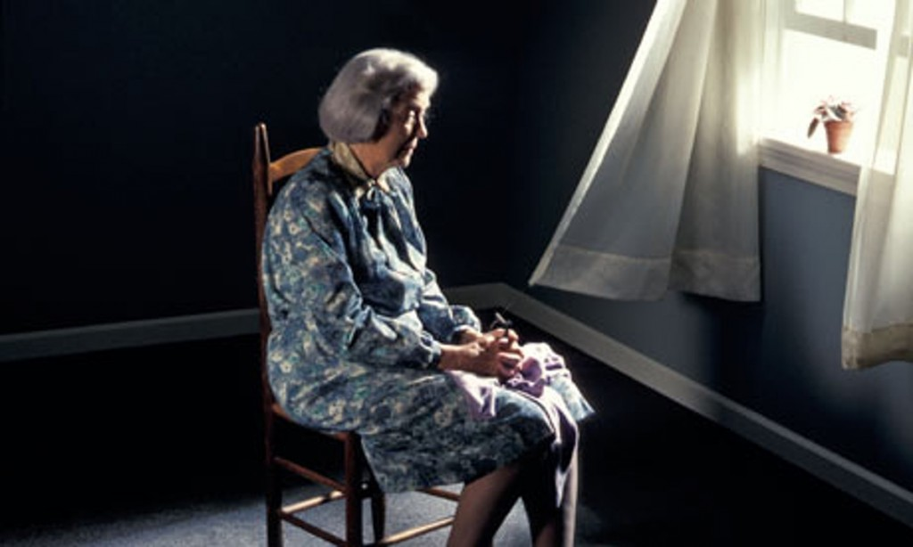
The Problem: The older you get harder to exercise
Social isolation
Fear of falling
Muscle atrophy
65+ y/o population will nearly double in next 20 years (70M+)
Notes:
Elderly patients place a high value on their independence and ability to walk and remain mobile. In fact, they report the loss of their mobility as one of the largest disadvantages of aging

Slide 4
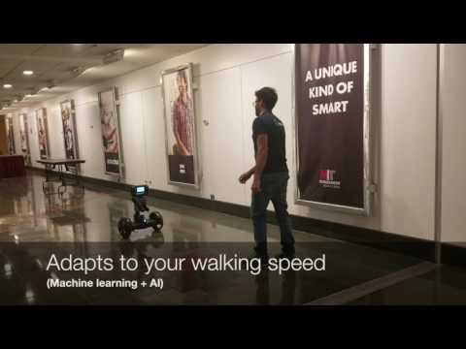
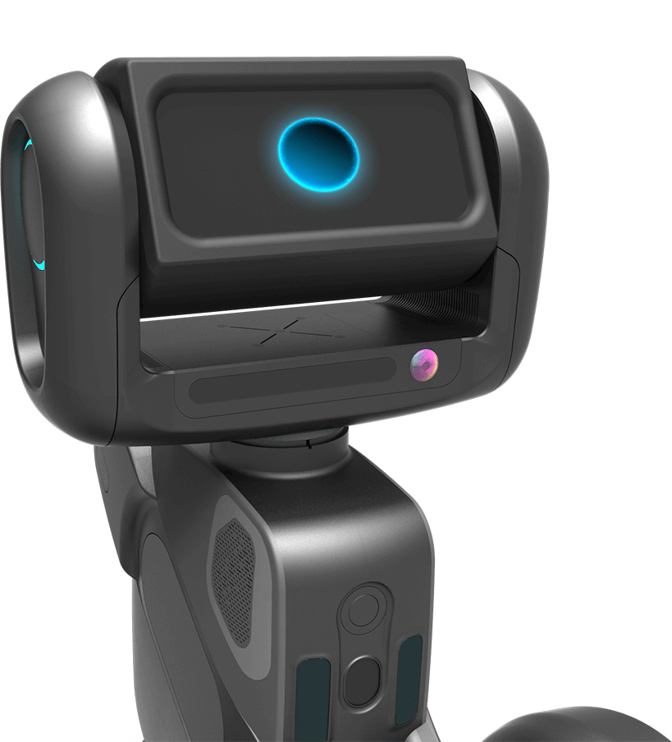
Our Solution: Personalized Walking Buddy
Notes:
https://www.youtube.com/watch?v=51XdcBMPrp0
The influence of social presence on acceptance of a companion robot by older people.
Our results show that a robot with more social abilities has a higher score on Social Presence and this results in a higher score on Perceived Enjoyment which again leads to a higher Intention to Use the system.
https://pure.uva.nl/ws/files/4248389/58668_285120.pdf
Skype with other Loomo users

Slide 5

Who Pays?
Caregivers
Notes:
20% are paying out of pocket expenses
The national median monthly rate for a one-bedroom unit in an assisted living facility is $3,500, according to the 2014 Cost of Care Survey released in April by Genworth Financial Inc. of Richmond, Virginia. That’s $42,000 per year, an increase of 1.45 percent over 2013. The cost has been rising by an average of 4.29 percent annually over the past five years. http://www.bankrate.com/finance/insurance/paying-for-assisted-living-1.aspx

Slide 6
Cost: $100/month subscription
Compare to:
$60/month Life Alert to alert you when someone falls
$150/month gym membership
Less than a Starbucks a day……!
Notes:
LifeAlert, Gym membership, Less than a Starbucks a day.
Current costs
67 million individuals are age 60 and older
10.5 million individuals have limited mobility¹
Nursing home costs can easily exceed $100,000 (or 234% of the median annual household income for people ages 65 or older)
Delaying entry into nursing homes or outside of the home care facilities can cost upwards of $100,000
https://www.census.gov/content/dam/Census/library/publications/2014/acs/acs-29.pdfN
g nursing homes this year = this this

Slide 7
Cost: $100/month subscription
Compare to:
$60/month Life Alert to alert you when someone falls
$150/month gym membership
Less than a Starbucks a day……!
More exercise --> less disease --> no nursing home
Save $10,000+/month
Notes:
LifeAlert, Gym membership, Less than a Starbucks a day.
Current costs
67 million individuals are age 60 and older
10.5 million individuals have limited mobility¹
Nursing home costs can easily exceed $100,000 (or 234% of the median annual household income for people ages 65 or older)
Delaying entry into nursing homes or outside of the home care facilities can cost upwards of $100,000
https://www.census.gov/content/dam/Census/library/publications/2014/acs/acs-29.pdfN
g nursing homes this year = this this

Slide 8

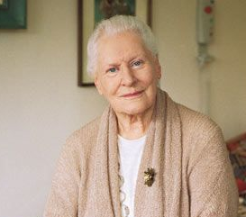

Go-to-market: Pilot Phase
Caregiver
Value and configuration
End-User
Fun and Safe
Clinician
Guidance

Slide 9


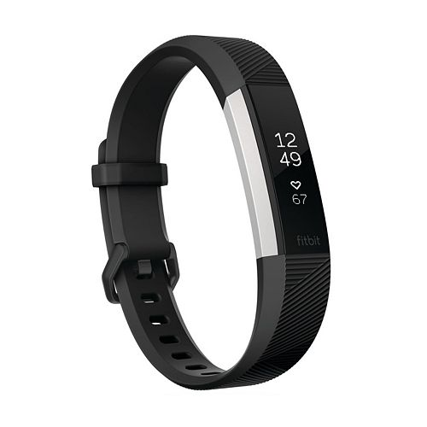



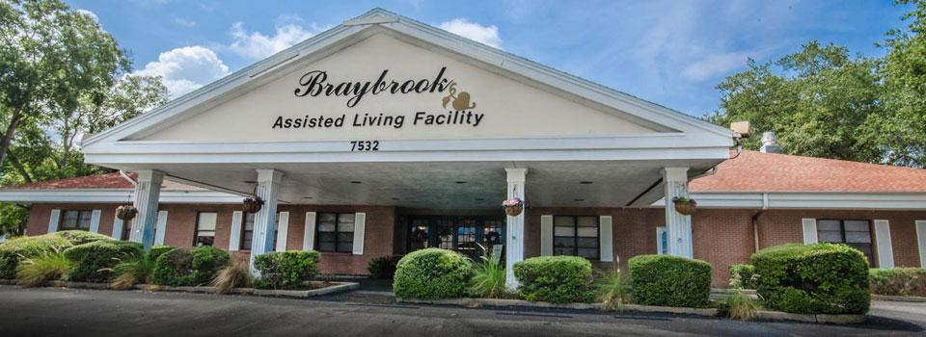
Go-to-market: Scale-Up Phase
Social
Additional Features
Clinical settings
Notes:
Explore clinical settings

Slide 10
A mobile, personalized walking companion available 24/7 to motivate you to walk

Slide 11
Appendix

Slide 12
Our Solution
Fogg Behavior Model:
Behavior = motivation * activation * trigger
high
Companion to encourage & motivate you
SUCCESS!
triggers succeed
motivation
triggers
fail
low
low
ability
high
Personalized regimen adapting to your ability
Safer because it monitors vital signs (less fear of falling)
Z

Slide 13
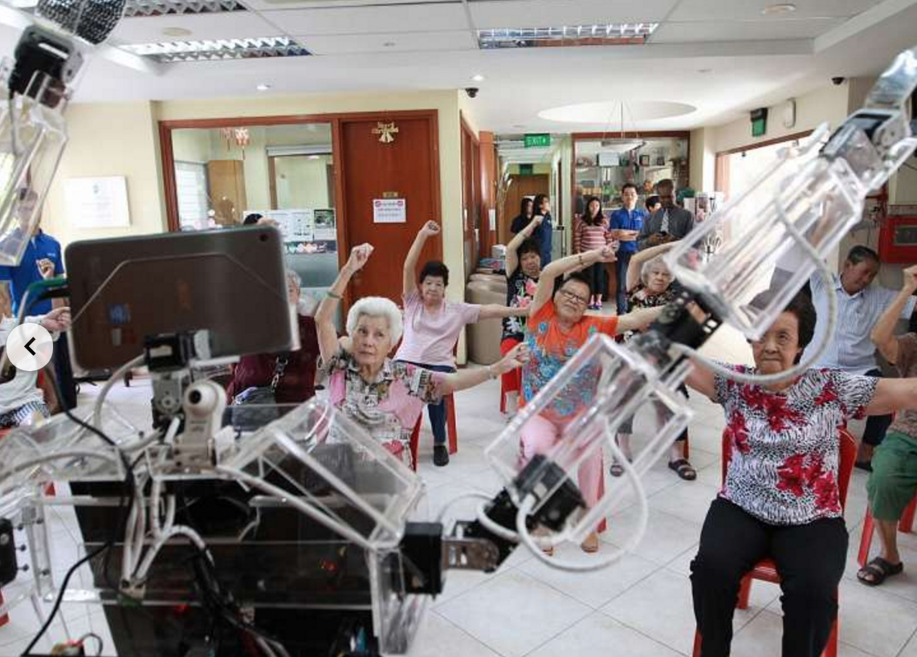
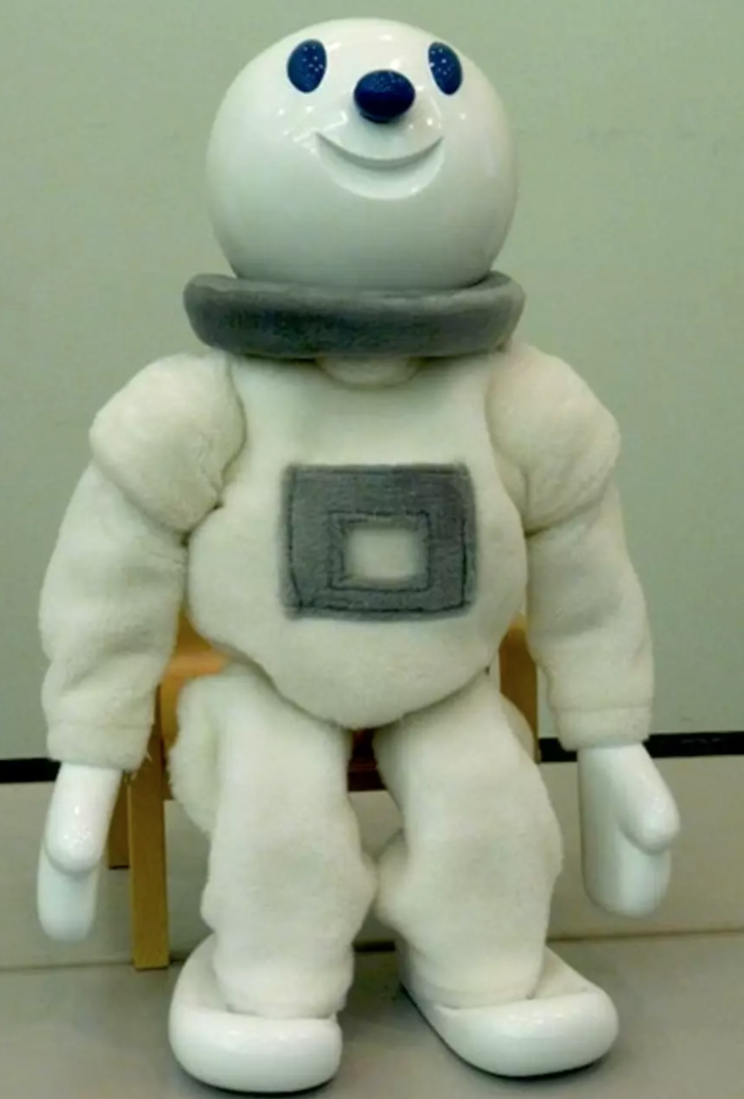
Competitors
“Xuan” = can give instructions on 15 simple arm exercises focusing on flexibility and circulation (Singapore)
“Taizo” = can demonstrate 30 different moves for his followers to imitate (Japan)
“GiraffPlus" = vacuum cleaner + standing mirror + a video-chat + health metrics monitor (Sweden)
“Elliq” = connect to digital content
“Cody” = give baths to elderly (USA)
Growing research field to improve mobility of the elderly, but not commercially available
“Design of an accompanying humanoid as a walking trainer for the elderly” 25th IEEE International Symposium Robot and Human Interactive Communication 2016.
“A Feasibility Study for an Accompanying Humanoid Robot to Monitor and Encourage Walking”
Notes:
http://www.roboticstomorrow.com/article/2015/12/the-new-family-member-a-robotic-caregiver/7312/
http://www.straitstimes.com/singapore/health/this-robot-exercise-coach-is-available-round-the-clock

Slide 14
Startup Costs year 1
Variable costs:
Loomo / robot $1,000 each (lasts ~4 years) 100 robots → $100,000
Fixed costs:
3 Software developers $90,000 / year
Market/Sales $80,000/year
Business development $90,000/year
Revenue:
$500 upfront cost
$100 per month rental per Lomo → $1,700 per year per Loomo → $170,000 per year for 100 Loomos
Market size:
65 million aged > 60
Notes:
The amount of people entering http://www.caregiving.org/wp-cont/2015/05/2015_CaregivingintheUS_Final-Report-June-4_WEB.pdf homes this year = this this

Slide 15
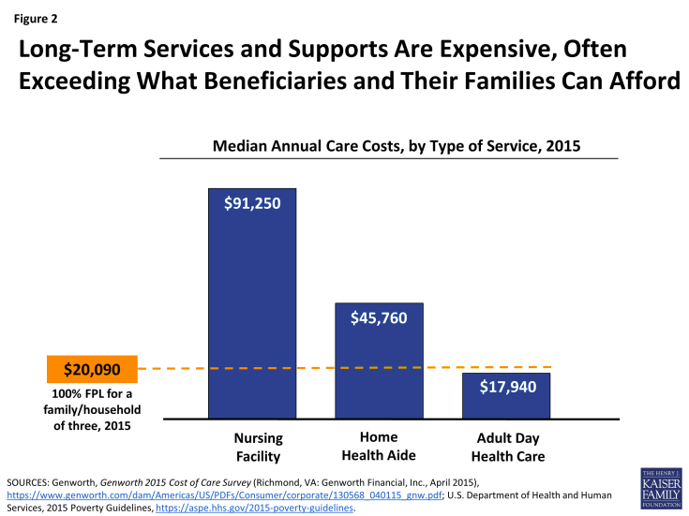

Slide 16
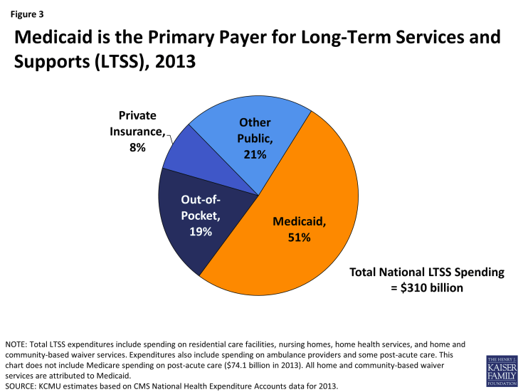
http://kff.org/medicaid/report/medicaid-and-long-term-services-and-supports-a-primer
According to Age U.K., nearly half of all people aged 75 and over live alone, and more than a third say they speak to less than one person a day.
http://kff.org/medicaid/report/medicaid-and-long-term-services-and-supports-a-primer/

Slide 17
Cash Flow
50M
CashFlow
2.5 years
Break Even
5
years

